Slide 1


Mini school business
OŠ Dolenjske Toplice
SLOVENIA

Slide 2
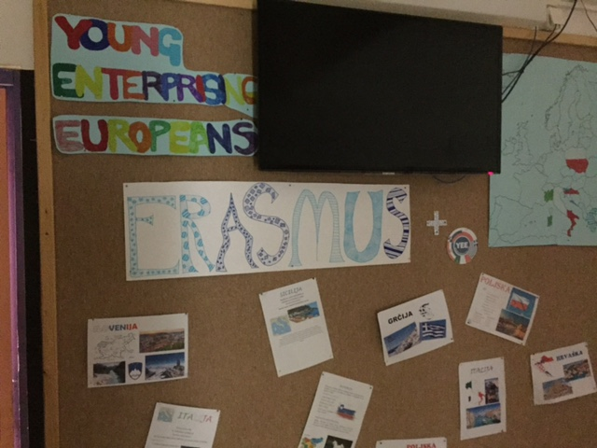
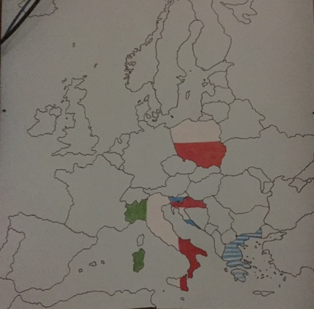
Project information table
A presentation of school partners and their countries
Time table of events
Diary

Slide 3
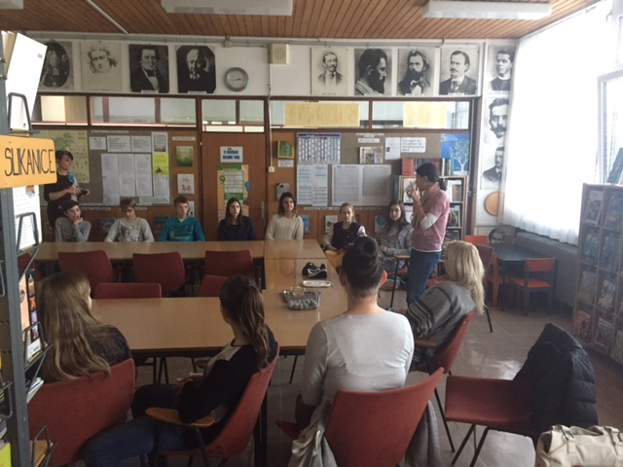
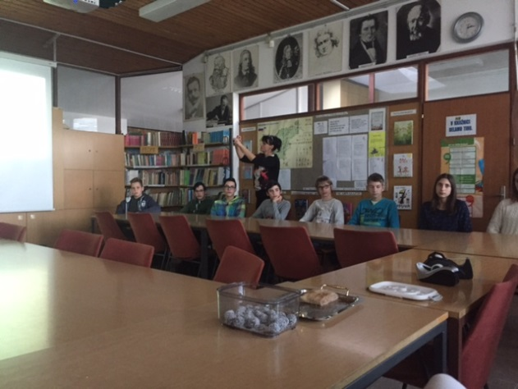
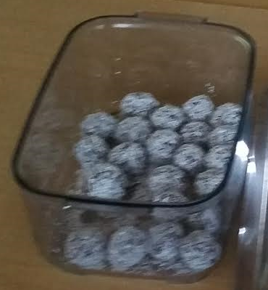
Enterpreneurship workshop
FIRST WORKSHOP
Economic school teacher introduced basic enterpreneurship topics
Warmer - Healthy sweets
13-15-years-old students

Slide 4
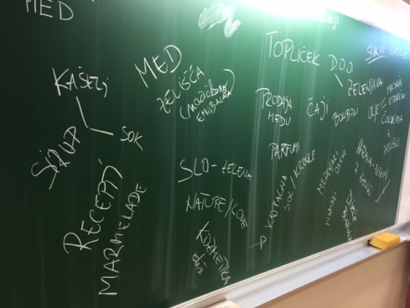
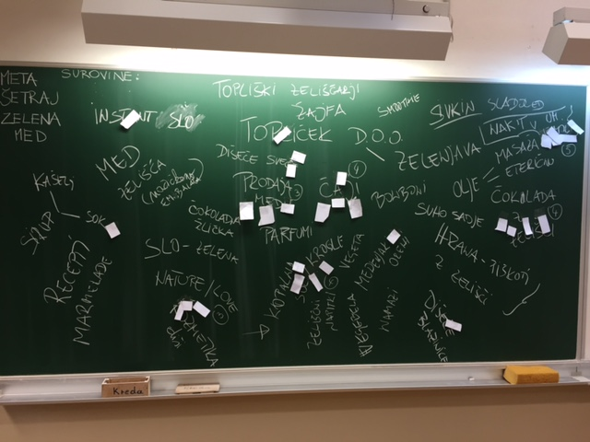
BRAIN STORMING – SEARCHING FOR IDEAS
STUDENTS
Searching for ideas – product, that COULD be developed
Product selection

Slide 5
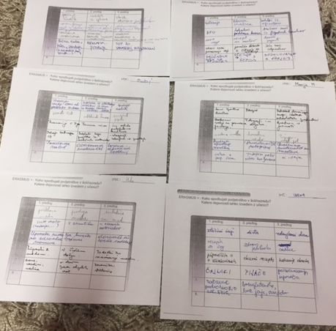
BRAIN WRITING – DEVELOPING IDEA
TEACHERS
the whole school
is included in the project

Slide 6
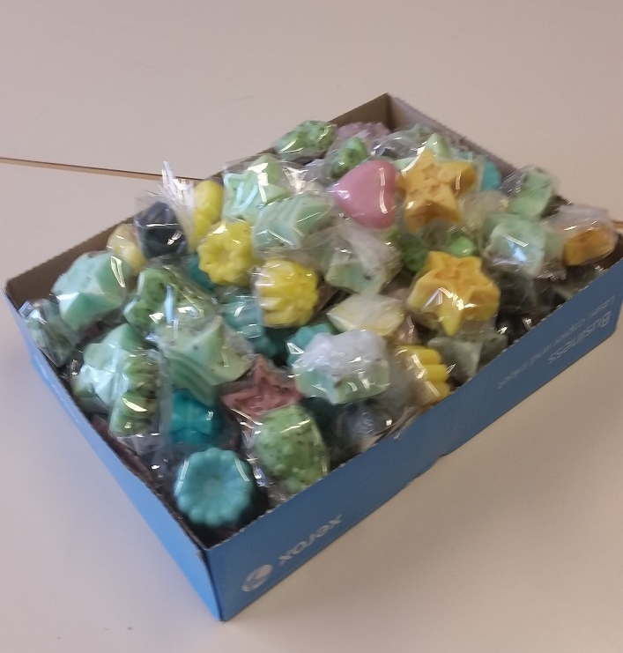
1. Product: HOMEMADE SOAP
INGREDIENTS :
For homemade soap we need base soap and dyestuff. If we want to spoil ourselves, we can also use some essential oil, glitter and dry flowers or herbs.
PROCESS:
Melt the base soap.
Add a dyestuff.
Fill the molds.
If you want, add some glitter.
Let it cool.
Take the cold soap out of the molds.
Pack and decorate.

Slide 7
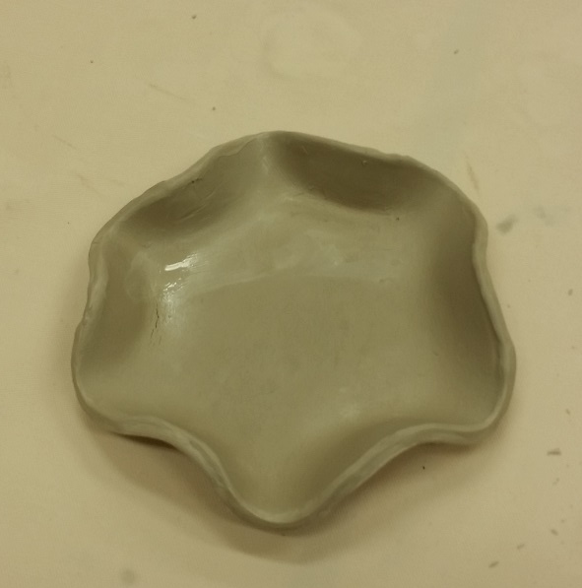
SOAP DISPENSER
WE NEED:
White clay
Containers
Plasctic knife
Lace
Cup of water
HOW TO MAKE
We cut a piece of clay
then we roll it out
We form a soap dispenser
we decorate it with lace
then shape the edges with water
after that, we leave clay to dry for two weeks
then we bake them in a ceramic klin
in the end we paint and varnish them.

Slide 8
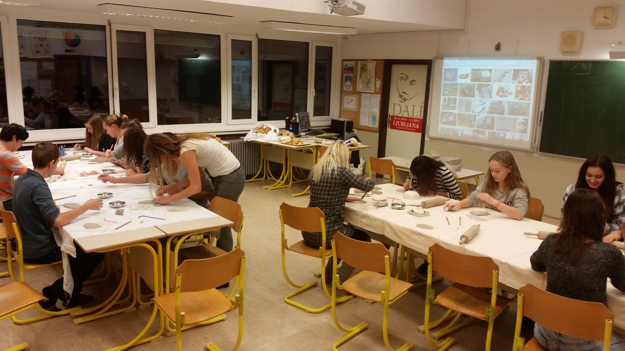
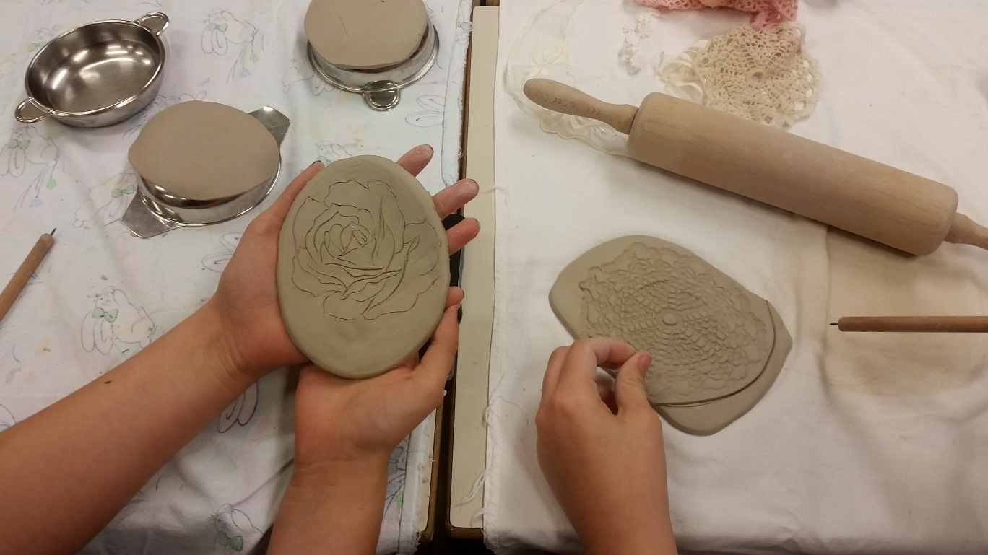

Slide 9
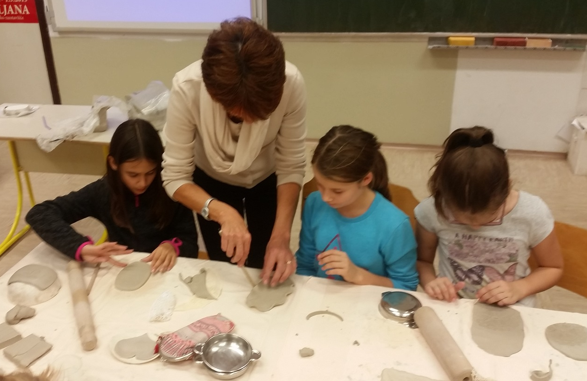
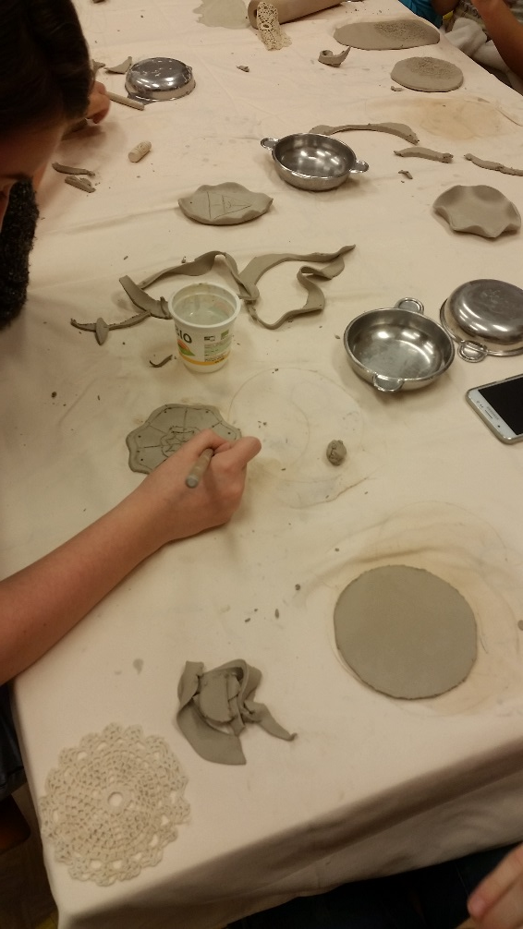

Slide 10
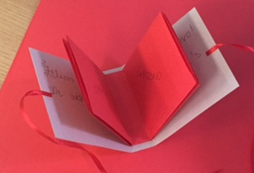
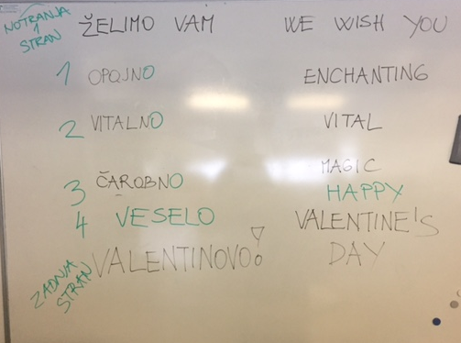
2. PRODUCT: VALENTINES DAY TEA-BAG BOOKLETS
MAKING PAPER TEA-BAG BOOKLETS FOR VALENTINES DAY
INDUSTRIAL TEA BAGS
GOOD WISHES

Slide 11
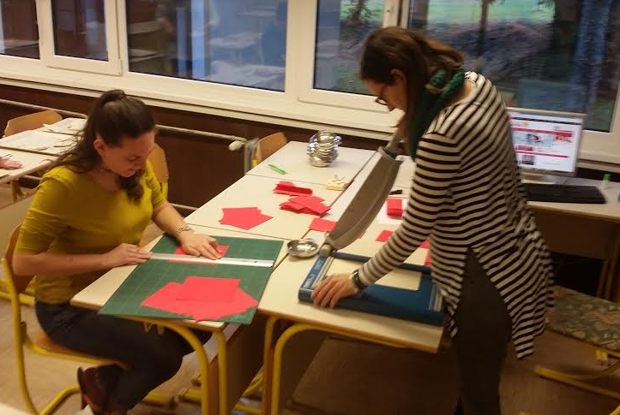
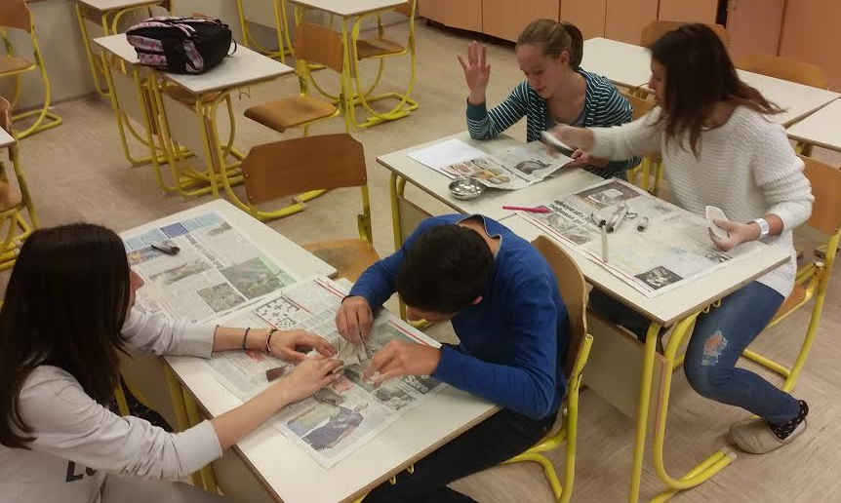

Slide 12
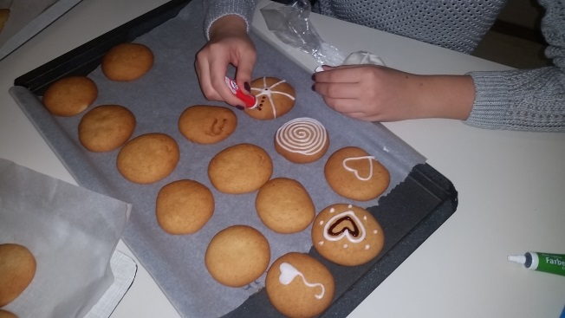
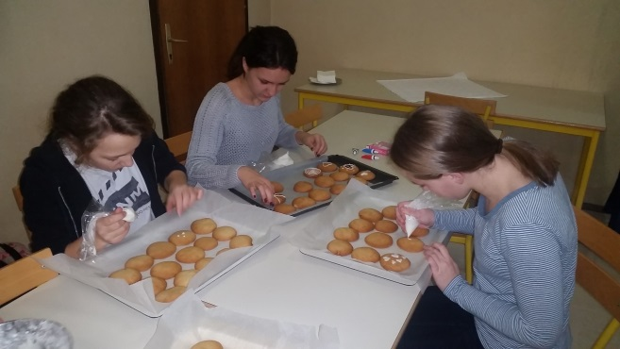
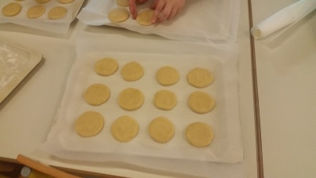
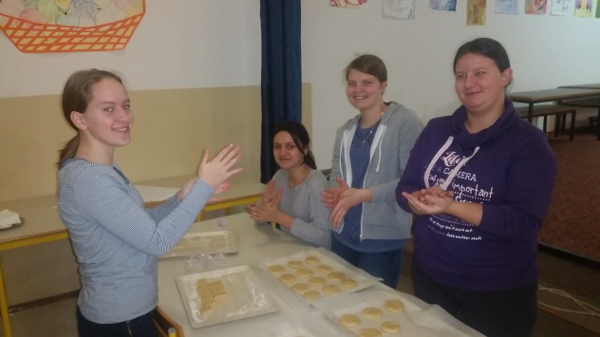
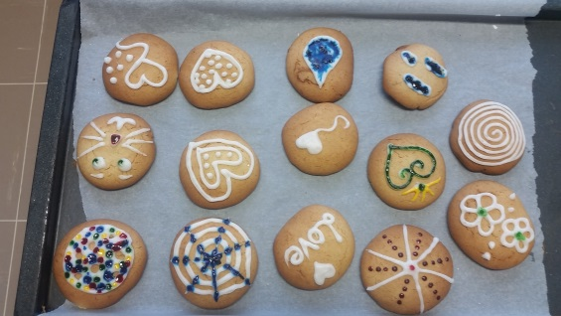
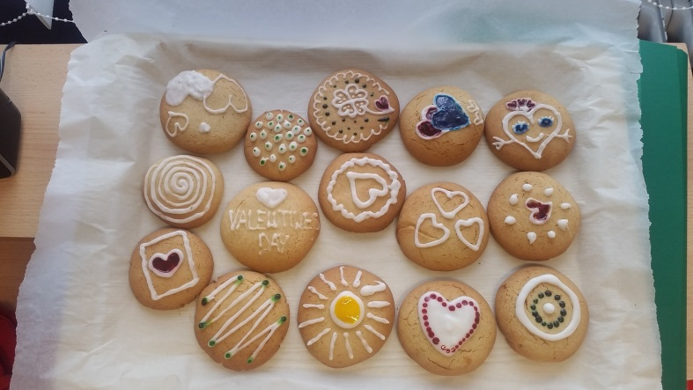
3.PRODUCT: GINGERBREAD (HONEY COOKIES)
USING HONEY FROM OUR SCHOOL BEEHIVE
DECORATED IN THE SPIRIT OF VALENTINES DAY

Slide 13
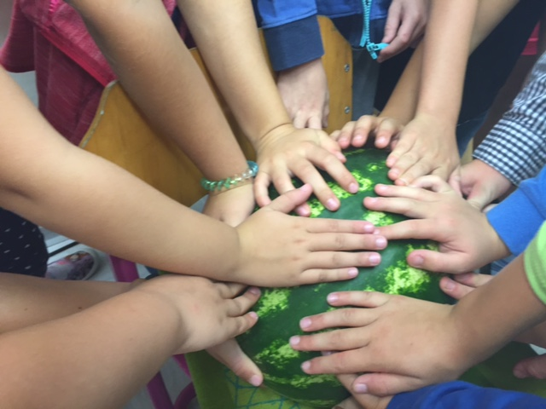
4.PRODUCT: SEEDLINGS
FOR PLANT FAIR IN CROATIA

Slide 14
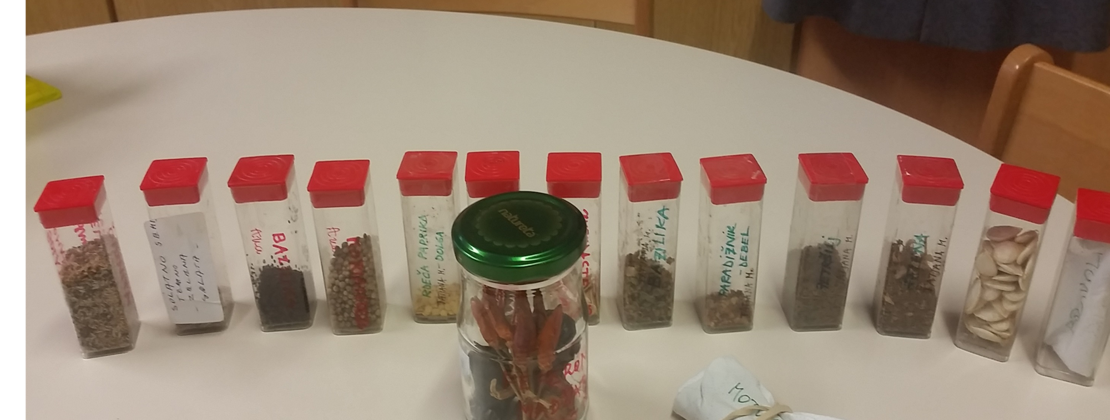

Slide 15
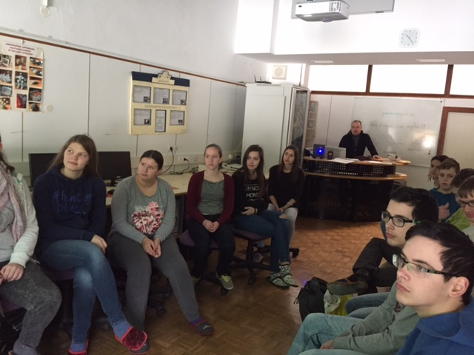
TAX EDUCATION
SECOND WORKSHOP
A representative of the Finance office explained why we should pay taxes.

Slide 16
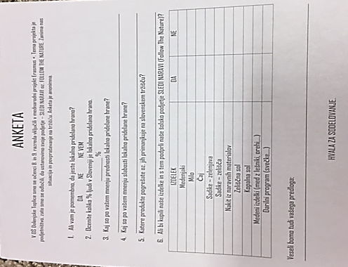
A SUPPLY-AND-DEMAND SURVEY
The pupils of the 8th and 9th grade of Primary School Dolenjske Toplice have joined an international project Erasmus +. The theme of the project is business. We have decided to develop our own company - FOLLOW THE NATURE. We are conducting a anonymous supply-and demand survey.
100 questionnaires were handed out.

Slide 17



LOGO of our company
Follow the nature

Slide 18

Sledi naravi

Slide 19
PLANS FOR THE FUTURE
Grow seedlings in our classrooms and in the school garden
Bussines manager – a workshop for teachers
Building a greenhouse
Visit some local companies

