Slide 1


Mini school bussines
OŠ Dolenjske Toplice
SLOVENIA

Slide 2
Project information table
Time table of events
diary

Slide 3
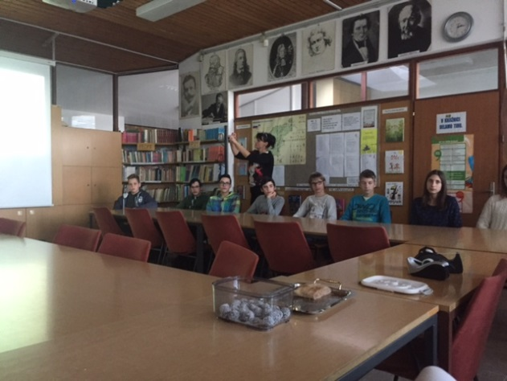
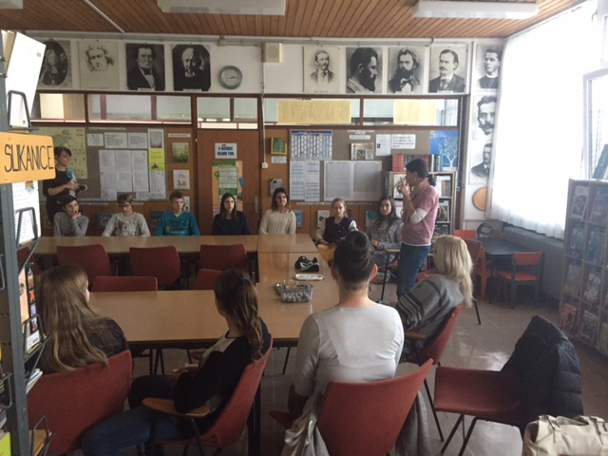
Enterpreneurship workshop
FIRST WORKSHOP
Economical High school teacher entroduced basic enterpreneurship topics.
START UP - Healthy snacks
Atended students 13-15 years old

Slide 4
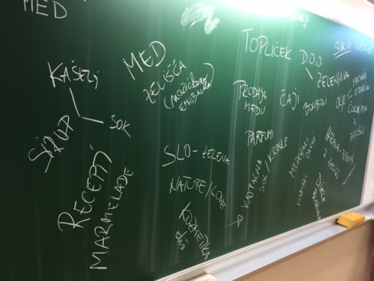
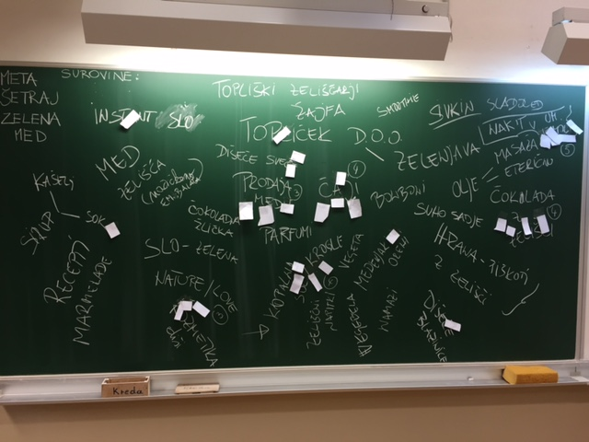
BRAIN STORMING – SEARCHING FOR IDEAS
STUDENTS
We were searching for ideas – product, that could be developed
Product selection

Slide 5
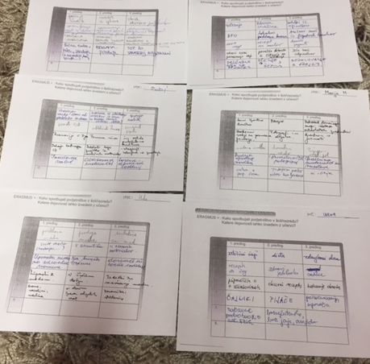
BRAIN WRITING – DEVELOPING IDEA
TEACHERS
ALL SCHOOL IS INCLUDED IN THE PROJECT

Slide 6
1. Product: HOMEMADE SOAP
INGRIDIENTS :
For homemade soap we need base soap and dyestuff. Course we also want to overindulge ourselfs, so we also need some essential oil, sparkles and dry flowers or herbs.
Process :
Melt the base soap.
Add a dyestuff.
Fill in the models.
If you want sprinkle in some sparkles.
Let it cool.
Take the cooled soaps out of models.
Put it in a package.

Slide 7
SOAP DISPENSER
WHAT DO WE NEED
White clay
Containers
Plactic knife
Lace
Cup of wather
HOW TO MAKE
We cutted a peace of clay
then we roll it
we put it into a shape of a soap dispenser
we decorate it with lace
then shape the edges with water
after that we leave clay to dry
dry it for two weeks
then we baked them in ceramic klins
at the end we paint and varnish them.

Slide 8
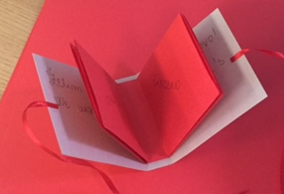
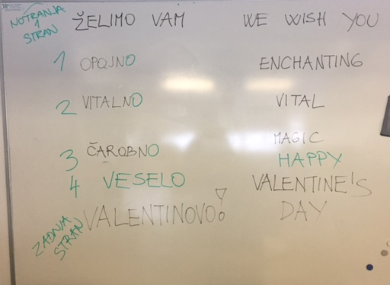
2. PRODUCT: TEA BAGS- VALENTINES DAY
CREATED PAPER TEA BAGS FOR VALENTINES DAY
USED INDUSTRIAL TEA
WITH GOOD WISHES

Slide 9
3.PRODUCT: HONEY COOKIES -
USING HONEY FROM SCHOOL BEEHIVE
DECORATED IN VALENTINES DAY SPIRIT

Slide 10
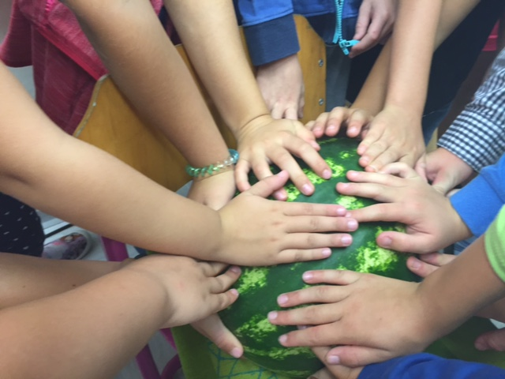
4.PRODUCT: SEEDLINGS
FOR PLANT FARE IN CROATIA

Slide 11
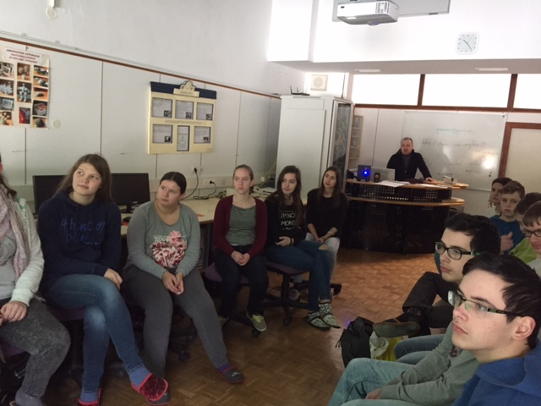
Tax education
SECOND WORKSHOP
Representative of Finance office- why paying and to what purpose

Slide 12
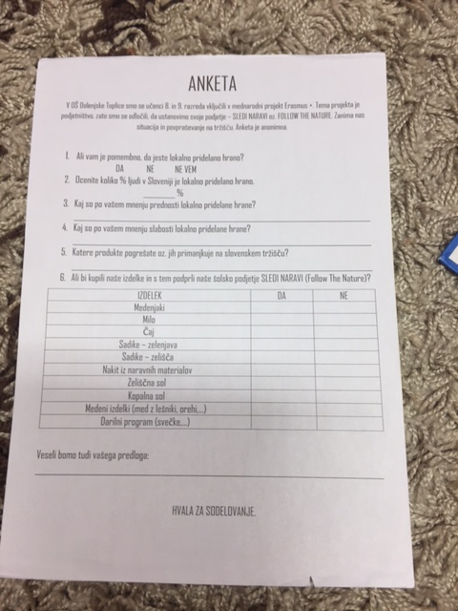
SITUATION AND DEMAND SURVEY
The pupils of 8-th and 9-th grade of primary school Dolenjske Toplice have joined international project Erasmus +. The subject of the project is business. We decided to develop our own company - FOLLOW THE NATURE. We are conducting a situation and demand survey. The survey is anonymous.
100 questionnaires

Slide 13



LOGO
Follow the nature

Slide 14

Sledi naravi

Slide 15
PLAN FOR THIS YEAR
grow seedlings inside and outside.
Bussines manager – workshop for teachers
Building greenhouse

